Slide 1
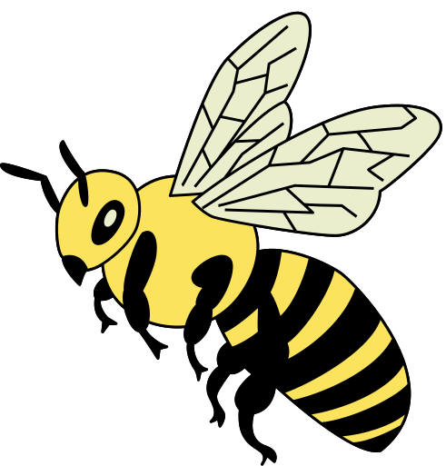


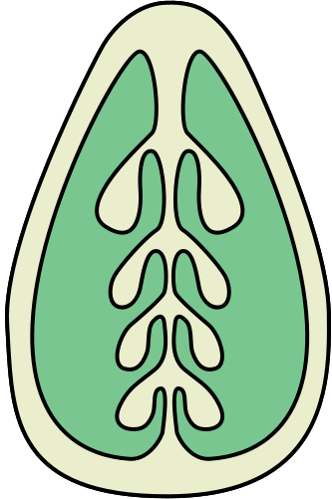
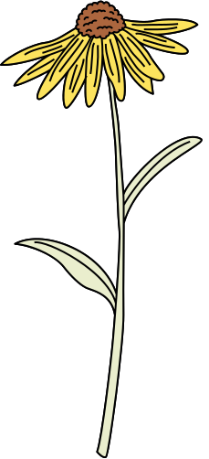
How Do
Flowering Plants Reproduce?

Slide 2

Structure of a Flower
Anther
Stamen
Male reproductive part of flowers
Stigma
Produces pollen, the male gametes
Sticky surface that captures pollen grains
Pistil
Female reproductive part of flowers
Filament
Style
Tip: Remember that stamen has ‘men’ in it, so it can be associated with the flower's male part.
Supportive stalk that holds up the anther
Long tube that connects the stigma to the ovary
Sepal
Ovary
Protective structures, shielding the delicate reproductive organs within
Contains the ovules, which, once fertilised, will develop into seeds
Petals
Attract pollinators and shield the delicate parts inside

Slide 3
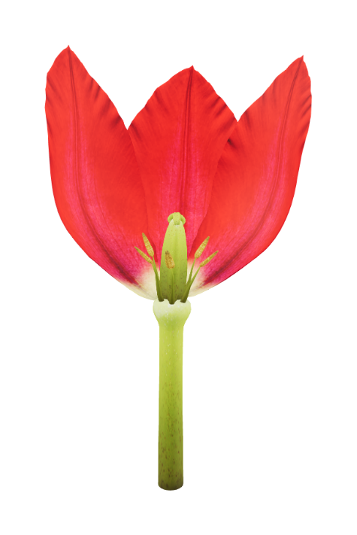
Let’s Review!
Earlier, you explored the parts of a hibiscus flower.
Now, let’s try to spot those same parts in a 3D model of a tulip.
Explore and zoom in on the model.
How many of the following parts can you find?
Petals
Stamen
Filament
Anther
Pistil
Ovary
Style
Stigma

Slide 4
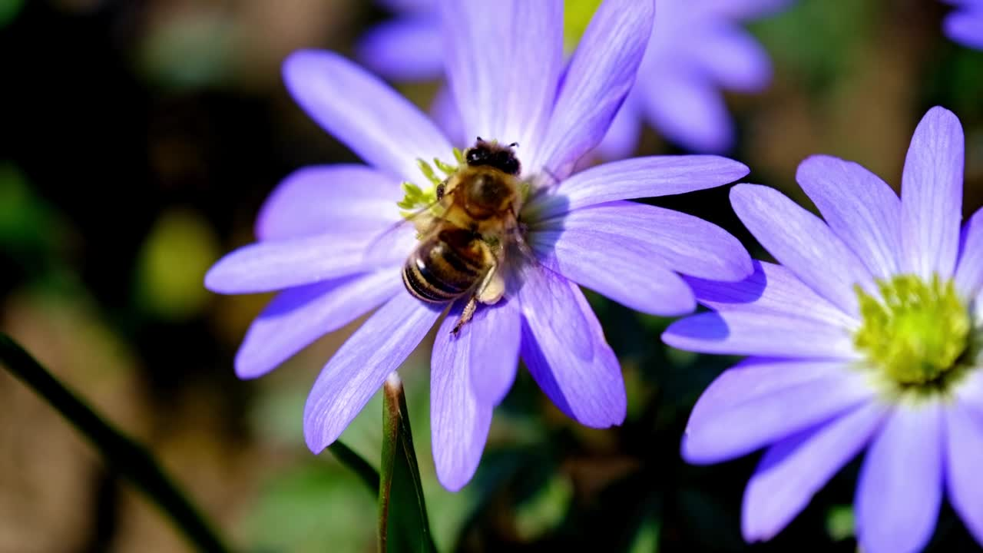
Pollination
What is it?
The process of transferring pollen grains from the male part (anther) of one flower to the female part (stigma) of another flower of the same species.
Why is it important?
It leads to seed formation, essential for plant growth and reproduction, and the production of fruits that humans can eat.

Slide 5


Methods of Pollination
Examples:
roses, daisies and sunflowers
Examples:
dandelion and grasses
By Insects
By Wind
Insects like bees and butterflies carry pollen from flower to flower while they collect nectar.
Wind can also carry pollen to other flowers. These pollen grains are lightweight and can be easily carried by the breeze.

Slide 6
Be a Pollination Expert!
Choose a specific plant or flower species.
Research and identify its pollination method
(e.g., insect, wind, water).
Describe the plant’s unique features and adaptations for attracting pollinators, such as:
Colour
Flower Structure
Scent

Slide 7
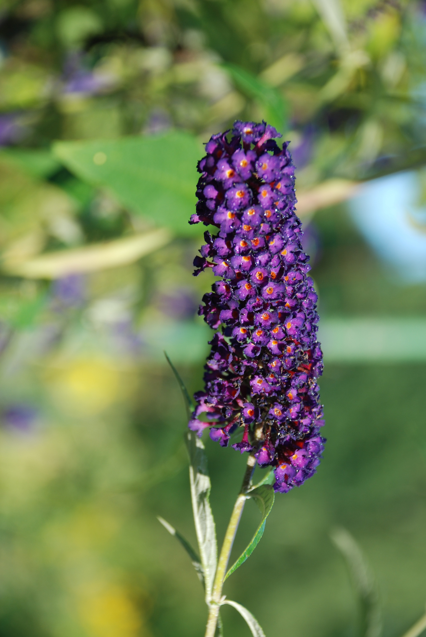
SAMPLE ANSWER
Be a Pollination Expert!
Plant or Flower Species:
Pollination Method:
Butterfly Bush
Insect (Butterfly) Pollination
Unique Features Supporting Pollination Method:
Colour:
Flower Structure:
Scent:
have vibrant colours like purple, pink and white to attract pollinators
have tubular shapes with a landing platform to encourage butterflies to access nectar and pollen
emit a sweet scent to entice butterflies

Slide 8


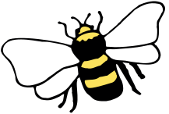

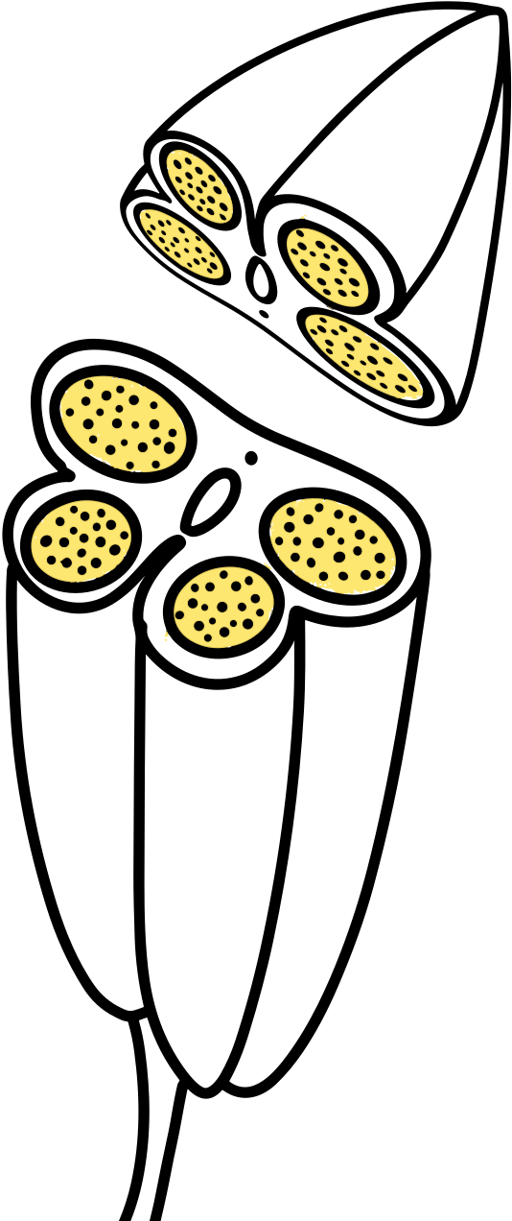
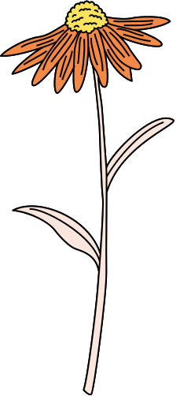
Process of Pollination
1
2
Pollen Production
Attracting Pollinators
The anther produces pollen, which contains the male reproductive cells (gametes).
The flower may use its colourful petals, fragrance or nectar to attract pollinators like bees, butterflies or birds.

Slide 9


Process of Pollination
3
4
Transfer of Pollen
Arrival at Another Flower
When a pollinator visits a flower for nectar or pollen, it brushes against the anther, picking up and carrying pollen grains on its body.
The pollinator moves to another flower of the same species (or a compatible one). Some of the previously collected pollen may rub off onto the stigma of the second flower.

Slide 10
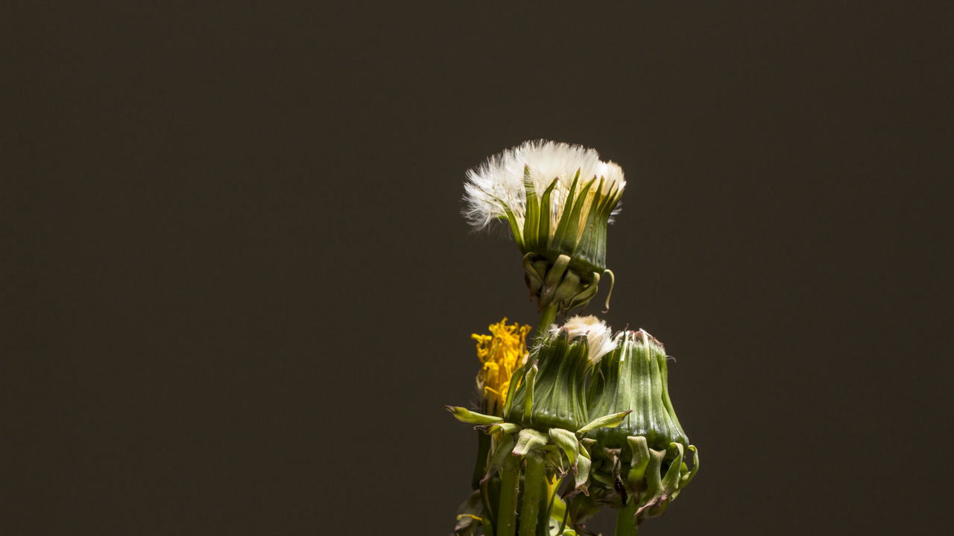
Fertilisation
What is it?
A process by which the male and female reproductive cells (gametes) combine to initiate the development of a seed.
Why is it important?
It is essential for maintaining the diversity of plant species, the functioning of ecosystems, and food production.

Slide 11

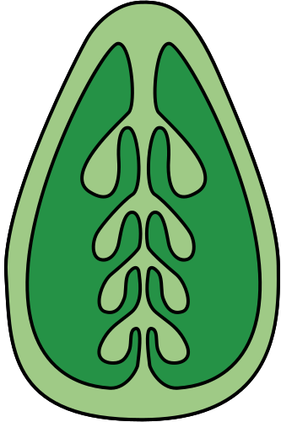
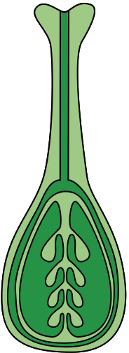
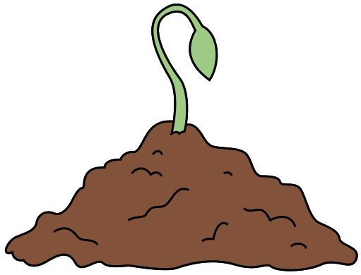
Process of Fertilisation
1
2
3
Fertilisation
Seed Dispersal and Germination
The pollen on the stigma germinates and sends a pollen tube down into the flower’s ovary. This tube delivers the male gametes to the ovule, where fertilisation occurs.
The mature fruit can be eaten by animals, carried by the wind, or float in water, allowing seeds to be carried to new locations and grow into a new plant.
Seed Formation
The ovule develops into a seed, and the flower’s ovary matures into a fruit, enclosing the seeds.

Slide 12


Thinking
Time!
Can you propose one method by which non-flowering plants reproduce?

Slide 13
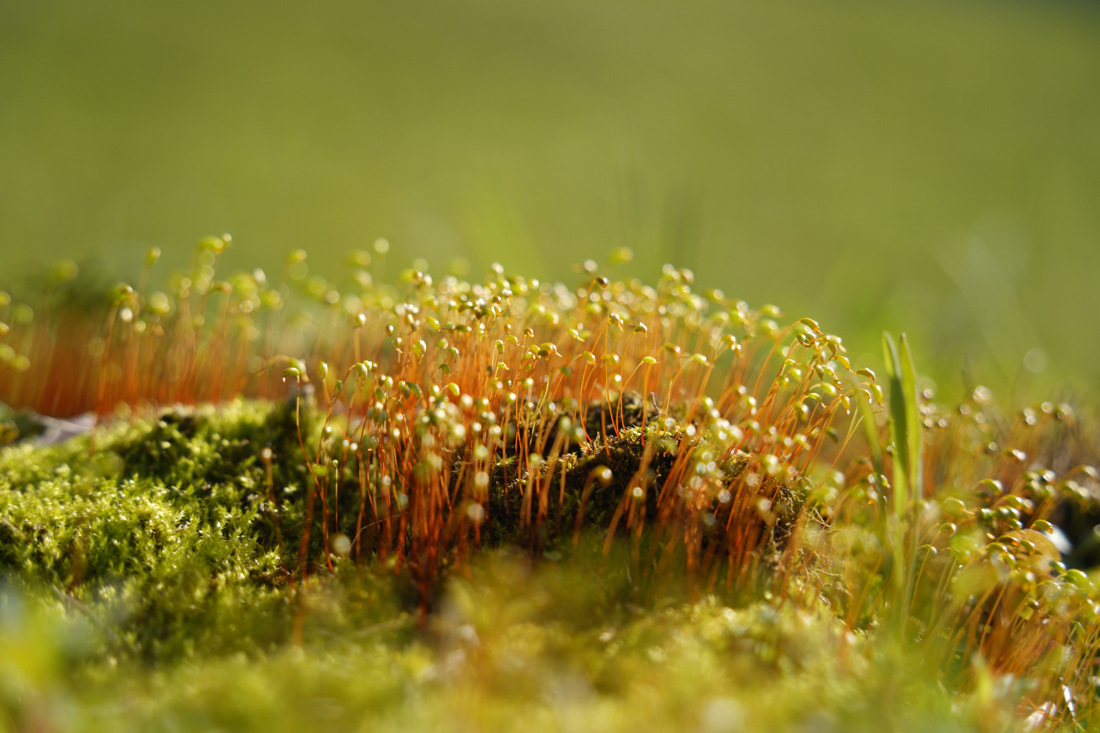
SAMPLE ANSWER
Thinking Time!
Spore Production:
Non-flowering plants like ferns, mosses and algae release tiny reproductive structures called spores.
These spores can be carried by wind or water to new locations, where they can grow into new plants.

Slide 14

Assignment
Sketch or take a photo of a flowering plant common in your local area.
Investigate the precise processes of pollination and fertilisation that allow it to reproduce.
Share your research findings on a Canva whiteboard.

